Slide 1
Angular
Introducción TypeScript, Webpack, Angular

Slide 2
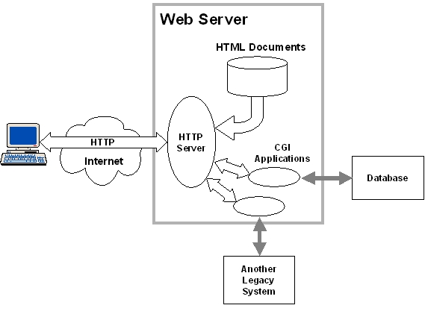
Angular – Modelo cliente - servidor
Fuente: http://www.sce.carleton.ca

Slide 3
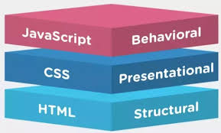
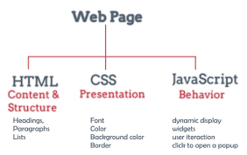
Angular – tecnologías cliente

Slide 4
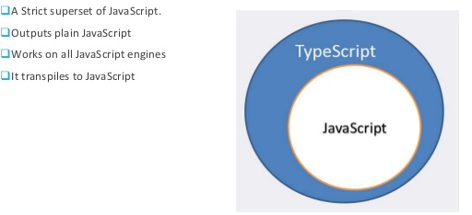

Angular – TypeScript
Strong typed language

Slide 5
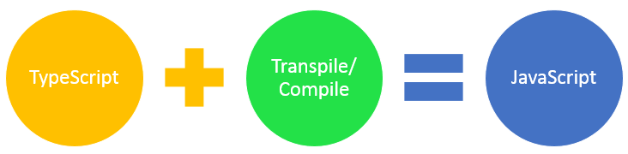
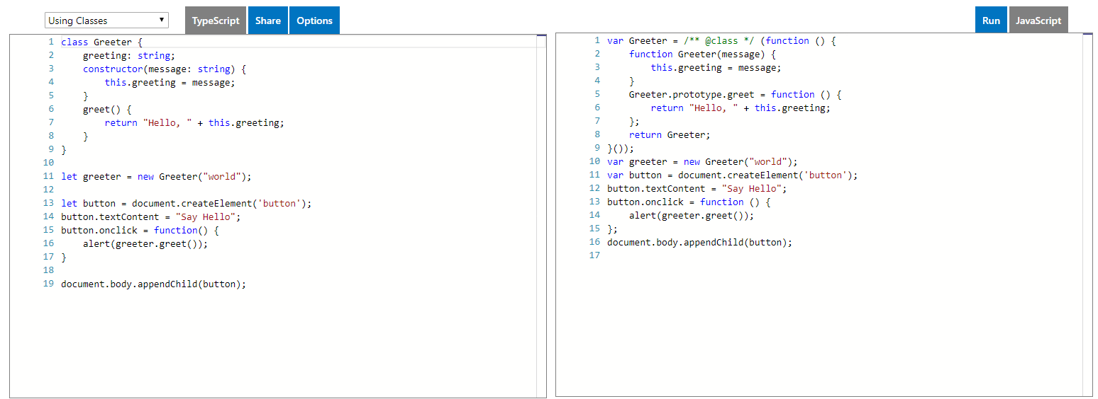
Angular – TypeScript
Typescript programming process
TypeScript Playground

Slide 6
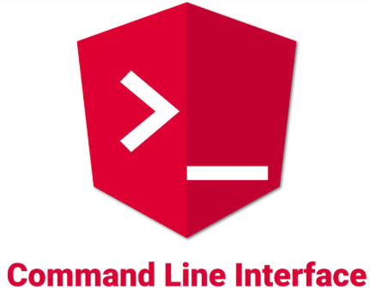
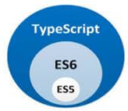

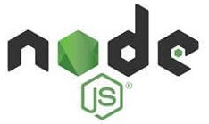

Angular – Tools

Slide 7
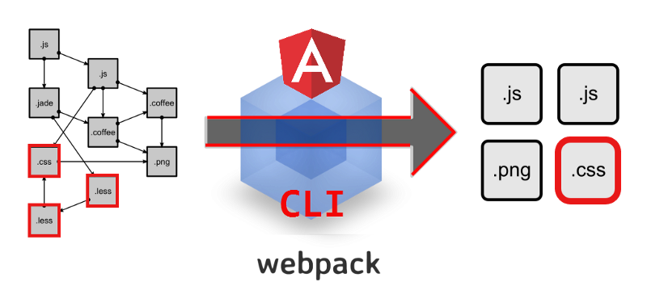
Angular – bundle process

Slide 8
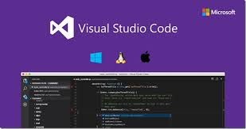
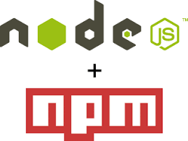

Tools
Code editor VS Code
Package management
Versioning,
NodeJS + npm: v6.11.2
Code repository
Team work
Versioning

Slide 9
NodeJS + TypeScript + WebPack
Basic Webpack + TypeScript App:
Create Project folder
Open folder with VSCode as admin
Open VS code terminal: Ctrl + ñ
Init new npm Project (package.json): npm init
As admin Install TS: npm install --save -dev typescript
Create TS configuration file: tsconfig.json
Install webpack: npm install --save -dev webpack
Install webpack CLI: npm install --save -dev webpack-cli
Setup TS + Webpack: https://webpack.js.org/guides/typescript/
Install TS and loader: npm install --save-dev typescript ts-loader
Edit tsconfig.json
Create and configure webpack.config.js file
Add code: index.html, /src and /dist folders
Compile Dev command: webpack
Compile Prod command: webpack –p
Install webpack dev server: npm install --save -dev webpack-dev-server
Install concurrently: npm install --save -dev concurrently
Setup start script: "start": "concurrently \"webpack-dev-server --open\" \"webpack -w\"",
Run app: npm start

